Slide 1
premium finance Express
Two hours continuing education credits

Slide 2
What we will cover
Premium finance in a nutshell
Insured options for premium finance
Who benefits from premium financing
How does premium finance work
The premium finance agreement: a close-up look
Responsibilities of each party
Current premium finance technology
How to get the most out of your premium finance company
Notes:
Premium Finance is a standard in the commercial P&C business as there are advantages to everyone involved. Every once in a while there is a problem and much of this class is a discussion about how to avoid the rarer event: the issues that have come up or could come up. This class will give you a better understanding of the whole process so you will be better able to help your customers.
Read the 5 bullets
We will talk about both the legalities of Premium Finance and Financial Risk involved in funding Insurance Premiums.

Slide 3
Premium Finance in a Nutshell

Slide 4
What is premium finance?
Premium financing provides a short-term loan for business and individuals to use to pay for insurance coverage.
LOAN TERM TYPICALLY LESS THAN ONE YEAR
FINANCE CHARGES PRE-COMPUTED AT THE BEGINNING OF THE LOAN AS OPPOSED TO DAILY INTEREST
FIXED INTEREST RATE
UTILIZES INSURANCE RETURN PREMIUM AS COLLATERAL

Slide 5


How big is premium financing
395 billion in commercial lines in the P&C industry
10% - 15% of all commercial lines P&C policies are financed
$50 billion in premiums financed

Slide 6





Who is involved in premium financing
PREMIUM FINANCE AGREEMENT
WHOLESALER/CARRER
PREMIUM FINANCE COMPANY
INSURED
AGENT
Notes:
A loan that is provided to give convenient payment options for insurance products.
The premium finance agreement is a contract between the insured and the finance company.
The finance company’s collateral is the unearned portion of the premium.
Who is involved? Finance Company
Insured
Agent
Wholesaler
Carrier

Slide 7
WHO OFFERS PREMIUM FINANCING?
Banks
Agencies
Wholesalers
Insurance Companies

Slide 8
Insured Options For
Paying Premiums

Slide 9
Insured options for paying premiums
Bank loans and lending institutions
Cash
Carrier/General Agent programs
Premium financing

Slide 10
Banks loans and lending institutions
Drawbacks:
Borrowing Capacity - Decreased
Approval Process - Lengthy review
Collateral - Company or Officer’s assets
Notes:
Bank loans - interest rate is usually fixed with a pfa vs. a bank usually variable
credit reference required with bank
complicated documents vs. easy pfa document
pfa quick approval process
pfa no application fees or closing fees which bank usually requires

Slide 11
cash
Drawbacks:
Takes immediate money out of pocket
Could be missing a tax advantage offered by financing
Could be missing reinvestment opportunities

Slide 12
Carrier/General Agent programs
Drawbacks:
Limited down payment and installment options
Multiple policies could mean multiple payees and/or billing cycles
Notes:
Sometimes Agents offer the “Best in Breed for each type of insurance – for example, AIG for Worker’s Comp, Chubb for property and Fireman’s Fund for General Liability.” Multiple carrier bill plans could create an administrative burden that Premium Finance could solve.
Carrier programs can be usually restrictive – if payment to carriers is late often cancelled with no reinstatement?

Slide 13
PREMIUM FINANCING
Benefits:
Borrowing Capacity: Unaffected, maintain liquidity
Approval Process: Simple, in most cases immediate with no required paperwork or information
Collateral: The return premium of the insurance policies themselves

Slide 14
Who Benefits
From Premium Financing

Slide 15
WHO BENEFITS FROM
PREMIUM FINANCING?
Agent
Wholesaler/Carrier
Insured

Slide 16


Agent benefits
Up Front Commissions
Reduced Administrative Time and Costs
Premium Finance Company Takes on Financial Risk
Provides Funding Mechanism for Insured to Afford All Coverages
Close Deal Quickly
Notes:
24/7 internet access to all available account information – ability to track financial status – pull notices, etc.
Provides complete insurance service – one stop shopping – solidifies your position as a full-service agency
Use as a sales tool. Give the financing proposal at the same time as quote – give several different payment options which makes you look good. Can help close the sale since the customer has a means to pay for the coverage. This way you can avoid opening the door for your competition.
Introduced the insured to a new lending source

Slide 17

Wholesale/carrier benefits
Premiums Paid in Full
Reduced Administrative Costs Associated with Billing and Collections
Premium Finance Company Takes on the Credit Risk, Not the Carrier

Slide 18
Insured benefits
Creates possible tax advantage/interest write-off
Optimizes cash flow
Provides a means to afford all coverage’s
Maintains existing ability to borrow
Allows convenient payment for all insurance policies
Notes:
#1 - The insured could afford more products to sell, or hire another person that could increase cash flow
#2 – Eases the burden of increased premiums
#3 – Simple contract provides account billing for all carriers and coverage's
# 4 - There are POSSIBLE tax advantages. We don’t know for sure since we are not tax consultants.
#5 – This is very important to companies in growth mode. Assets and liabilities balance out on the balance sheet because the RP is considered an asset.
But to determine the advantage to the customer, we can do a Quote analysis. To get this, you would have to call the branch and find out. The quote analysis is based on the tax credit the customer would get from the write-off as well as the money they would make from the cash investment.

Slide 19
GAME TIME!
ROUND ONE

Slide 20
GAME RULES
Correct answer = one point
First person to raise hand answers for the team
If incorrect, the other team will have the opportunity to answer
Not partial credit given
Jude’s decision is final

Slide 21
QUESTION #1:
Name all four parties involved in the premium finance relationship.
Notes:
Premium Finance Company
Agent/MGA/Broker
Carrier
Insured

Slide 22
QUESTION #2:
What is the estimated dollar amount of insurance financed in the US each year?
Notes:
50 Billion

Slide 23
QUESTION #3:
What is one benefit of premium financing to the Wholesaler/Carrier?
Notes:
Premium paid in full
Reduces administrative costs associated with billing and collections
Premium Finance Company assumes risk of payment exposure

Slide 24
QUESTION #4:
What is the collateral in a premium finance transaction?
Notes:
Return Premium

Slide 25
QUESTION #5:
What is another major benefit of premium financing for the agent?
Notes:
Commissions up front
Reduced administrative time and costs
Provides funding mechanism for insured to afford all coverage’s
Close deal quickly

Slide 26
QUESTION #6:
What’s an advantage of financing insurance premiums over using cash?
Notes:
Premium finance does not change the ability to borrow
Cash is available for other opportunities/needs
Premium finance charge offers a tax deduction

Slide 27
ROUND ONE
COMPLETE

Slide 28
How Does Premium Financing Work?

Slide 29

What is exposure?
The amount in money that the premium finance company stands to lose at any point in time if the insured defaults on payment.

Slide 30
Components of the loan that determine the risk
Policy Premium Amount – Taxes & Fees
Collateral – Unearned premium
Terms – Structure
Provisions
Premium Finance Agreement
Notes:
If I wanted to borrow money, would you lend it to me? What would go into your decision? Would you lend it to anyone?
Components of the Loan and Risk, in other words, what does a Finance Company have to take into account when funding a policy?
Policy Premium Amount – the amount of the loan is going to affect how it’s treated. A Loan for 3 million would be treated differently than a loan for 25 thousand.
Collateral. The collateral of the loan is the unearned premium. We will discuss the basics of collateral and then talk about what will influence the collateral, and hence the financial risk of the loan.
Terms or the structure and the exposure of each term when there are no extenuating circumstances.
Provisions are the extenuating circumstances, or the details that can add exposure to the loan. They include a high minimum earned or seasonal policies … we’ll go over each in more detail.
Type of policy will influence the financial risk
Finally we will talk about the taxes and fees and the financial risk involved in financing them.
PFA – We’ll cover this in detail later

Slide 31
Policy premium taxes & fees
Premium established by carrier
Refundable or non refundable taxes
Refundable or non refundable fees
Notes:
Taxes and fees should be shown separate from the premiums. If taxes and fees are refundable, they can be financed.
Fees are usually placed in the down payment but may be financed as refundable with a letter stating the agent will return the unearned portion should cancellation occur.
In a fee legal state, the agent may also add a fee which will be reflected in the APR
A refundable fee may be financed without recourse depending upon the situation

Slide 32



Collateral
Unearned premium is determined by:
Policy Earnings: short rate/pro rata
Term and structure
Policy provisions
Minimum earned premiums
Accelerated earnings
Fully earned clauses
Cancellation days
Audits
Notes:
Ask class the influences on collateral before bringing in the options

Slide 33
Pro-rata vs short rate
Policy earns according to the state rules
Pro-rata earns 1/365/day
There are 11 states which earn on a pro-rata basis
CA, MD, MI, MN, MS, MT, ND, NY, OR, RI, ad TN
Short rate earnings carry a 10% penalty for cancellation (approximately)
The remaining states earn on a short rate basis
Notes:
Does everyone understand the difference between short rate and pro rata?
Pro Rata is the daily earning basis of the policy. Divide the number of days the policy runs by the number of days in the policy period.
Short rate is 90% of pro rata
Is your state short rate or pro rata?

Slide 34
Terms and structure exposure
Standard terms for general lines of business:
20% down with 9 payments
Other Structures:
10 equal payments | 35% down with 7 payments | 12 equal payments
      Terms will fluctuate based on industry, insured credit worthiness, amount of premium, and policy type.
Notes:
For Other Structures: terms fluctuate based on industry, insured credit worthiness, amount of premium, policy type, etc.

Slide 35
Exposure 20/9 on a $100,000 Loan
Policy: Short-Rate
Month 1 | ($6,151.35)
Month 2 | ($4,601.20)
Month 3 | ($3,151.05)
Month 4 | ($1,400.90)
Month 5 | $0
Month 6 | $0
Month 7 | $0
Month 8 | $0
Month 9 | $0
Notes:
Remember this is money the premium finance company will not get back if the insured cancels on any given month.
So, if the insured cancels on month 3, for example, and the premium finance company collects the unearned premium from the carrier, the premium finance company will be short by $3151.05.

Slide 36
Exposure 15/10 on a $100,000 Loan
Policy: Pro-Rata
Month 1 | ($1,750.90)
Month 2 | ($1,475.81)
Month 3 | ($1,200.72)
Month 4 | ($625.63)
Month 5 | ($350.54)
Month 6 | $0
Month 7 | $0
Month 8 | $0
Month 9 | $0
Month 10 | $0
Notes:
So, if the insured cancels on month 3, for example, and the premium finance company collects the unearned premium from the carrier, the premium finance company will be short by $1,200.72.
Remember this is money the premium finance company will not get back if the insured cancels on any given month

Slide 37
Exposure for 10 equal payments on a $100,000 loan
Policy: Short Rate
Month 1 | ($16,173.75)
Month 2 | ($13,510.00)
Month 3 | ($10,946.25)
Month 4 | ($8,082.50)
Month 5 | ($5,418.75)
Month 6 | ($2,555.00)
Month 7 | $0
Month 8 | $0
Month 9 | $0
Notes:
In this example, how much will the PF company be out if the insured cancels on the second month? ($13,510.00 or 14% of the original loan.) You can see the PF company has a lot more at risk, over twice as much, as the first example.

Slide 38
Exposure for 10 equal payments on a $100,000 loan
Policy: Pro-Rata
Month 1 | ($6,373.75)
Month 2 | ($4,610.00)
Month 3 | ($2,846.25)
Month 4 | ($782.50)
Month 5 | $0
Month 6 | $0
Month 7 | $0
Month 8 | $0
Month 9 | $0
Notes:
In this example, how much will the PF company be out if the insured cancels on the second month? ($4,610.00 or 5% of the original loan.)

Slide 39
Exposure for 12 equal payments on a $100,000 loan
Policy: Short-Rate
Month 1 | ($18,427.61)
Month 2 | ($17,425.10)
Month 3 | ($16,522.59)
Month 4 | ($15,320.08)
Month 5 | ($14,317.57)
Month 6 | ($13,115.06)
Month 7 | ($12,212.55)
Month 8 | ($11.210.04)
Month 9 | ($9,507.53)
Month 10 | ($8,605.02)
Month 11 | (7,402.51)
Notes:
First payment of twelve equals is the down payment. It’s only 11 payments
On this example, there is exposure on all months but the last.

Slide 40
Exposure for 12 equal payments on a $100,000 loan
Policy: Pro-Rata
Month 1 | ($8,627.61)
Month 2 | ($8,525.10)
Month 3 | ($8,422.59)
Month 4 | ($8,020.08)
Month 5 | ($7,917.57)
Month 6 | ($7,515.08)
Month 7 | ($7,412.55)
Month 8 | ($7,310.04)
Month 9 | ($6,307.53)
Month 10 | ($6205.02)
Month 11 | ($5,902.51)
Notes:
First payment of twelve equals is the down payment. It’s only 11 payments

Slide 41
Exposure for 35/7
Policy: Short Rate or Pro-Rata
Month 1 | $0
Month 2 | $0
Month 3 | $0
Month 4 | $0
Month 5 | $0
Month 6 | $0
Month 7 | $0
Notes:
With this structure, the PF Co has no exposure at all. Has anyone seen this structure? When is it used? (Bankrupt parties, poor credit, etc.)
If you wonder why we take this much down think about it this way. What if we gave them the standard short rate of 20 & 9 and they defaulted on the 3rd payment (go back to slide # 37) – see how much we would not get back in return premium? Where do we usually go for that? The insured! Well if the insured was bankrupt and the return premiums were not sufficient – if they defaulted then they would be out of business with no assets – the premium finance company loses.

Slide 42
Collateral/structure-exposure
Which Structure has more exposure?
35 percent down/7 monthly payments
12 Equal payments

Slide 43
Contract provisions that determine risk
Earnings
Cancellation
Types
Minimum Earned Premium
Fully Earned Premium
Accelerated
Retro
Short Rate/Pro Rata
Standard
Extended
Audits
Fleets
Directors & Officers
Contractors
Professional Liability

Slide 44
Earnings
Minimum Earned Premium:
This portion of the premium is earned at inception, regardless of the earning schedule
This is not refundable in event of a cancellation
Typically, 25%
Fully Earned:
Directors & Officers - Becomes fully earned in the event of bankruptcy or change of control
Hull - Becomes fully earned in the event of a total loss
Aircraft - Becomes fully earned in the event of a total loss

Slide 45





Methods of Earnings
Accelerated Earnings:
Seasonal Programs
Agricultural aviation
Wind Policies due to hurricanes
Retro:
It’s important to know if the policy is guarantee cost or a retrospective policy
This is typically for a WMC policy
Short Rate/Pro Rata
Policy earns according to the state rules

Slide 46
Cancellation
Standard:
Varies from state to state.
Typically, 10 days.
Extended:
Government filings requires that trucks not cancel for 30 days after non-payment.
The insured (third party) must be given notification.
Audits:
Workers comp: based on payroll.
General Liability: based on gross sales.
Auto: based on mileage.
Take anywhere from 60-180 days.
Impacts our collateral due to delay in receiving return premium.

Slide 47




Policy types
Professional Liability
Trucking
Directors and Officers
Construction

Slide 48
Finance charge and interest
The APR does not determine the finance charge. It is determined by the loan terms, and duration of the loan.
Earns more in the beginning of loan than upon completion
Important if policy is cancelled early in the payment schedule
Notes:
Just like a 30 year mortgage will pay more interest on a loan of the same amount for 15 years, longer terms are more likely to carry longer finance charges.

Slide 49
Rule of 78s
The rule of 78s is a method of earning or accruing the finance charge over the term of the loan. It is based on the sum of the digits of the total number of payments on the loan.
For a 12-payment loan:
      12+11+10+9+8+7+6+5+4+3+2+1=78
Remember, a standard loan in nine months

Slide 50
GAME TIME!
ROUND TWO

Slide 51
GAME RULES
Correct answer = two points
First person to raise hand answers for the team
If incorrect, the other team will have the opportunity to answer
Not partial credit given
Jude’s decision is final

Slide 52
QUESTION #1:
What is one component of a premium finance loan?
Notes:
Premium Finance Agreement
Collateral – Unearned Premium
Terms – Structure
Provisions
Policy Premium, taxes & fees

Slide 53
QUESTION #2:
True or False?
Exposure refers to how much money the premium finance company stands to earn
from finance charges at any point in time.
Notes:
False

Slide 54
QUESTION #3:
Which structure has the least exposure?
12 equals
20% down with 9 payments
35% down with 7 payments
Notes:
C) 35/7

Slide 55
QUESTION #4:
When should any information that could affect the collateral of the loan be disclosed?
Notes:
At the beginning of the quote process

Slide 56
QUESTION #5:
Which structure has the most exposure?
12 equals
20% down with 9 payments
35% down with 7 payments
Notes:
A) 12 equals

Slide 57
QUESTION #6:
True or false?
Because of the ten percent penalty, a policy which earns short rate earns faster than a policy that is pro rata.
Notes:
True

Slide 58
ROUND TWO
COMPLETE

Slide 59
The Premium Finance Agreement
A Close-Up Look

Slide 60
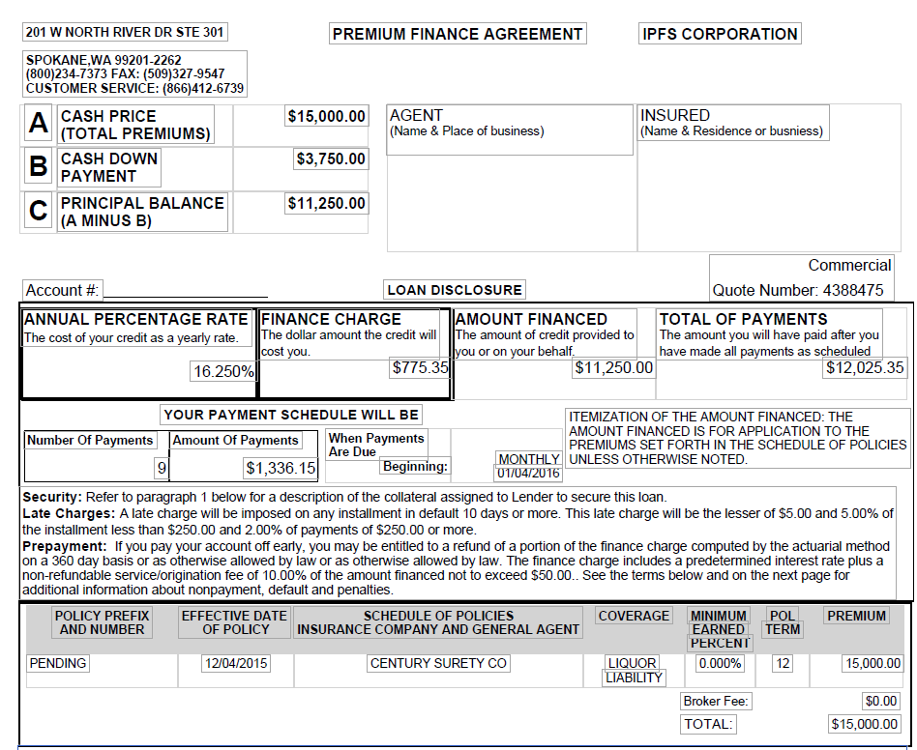
Premium finance agreement
Notes:
There are many styles to premium finance contracts – but they all have this information in common. They will tell you the Total Premium, Cash Down Payment, Amount Financed, Finance Charge, Total of Payments, Annual Percentage Rate, and the Payment Schedule (including the first due date).

Slide 61
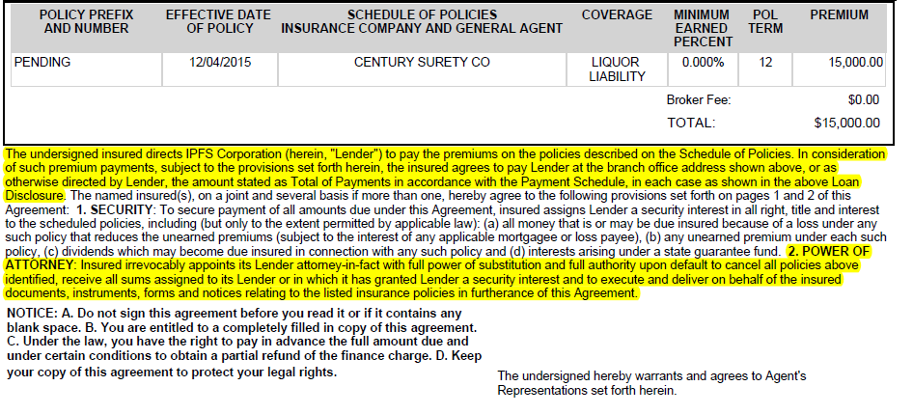
Premium finance agreement

Slide 62
Agreement highlights
The undersigned insured agrees to pay the lender total payments in accordance with the payment schedule per the schedules of financed policies.
The insured appoints the lender attorney-in-fact per the schedule of financed policies
Notes:
This is the language that assures that the lender will get its money back and the insured knows of the payments due and due dates!
Section 2 – language in the contract regarding the insured’s appointment of the lender as attorney-in-fact. The rights are stated as:
Cancel the contract in accordance with provisions in the contract.
Receive all sums assigned to the lender, and 2) execute a deliver on behalf of insured/undersigned all documents, forms and notices relating to the policies listed in the schedule of policies.

Slide 63
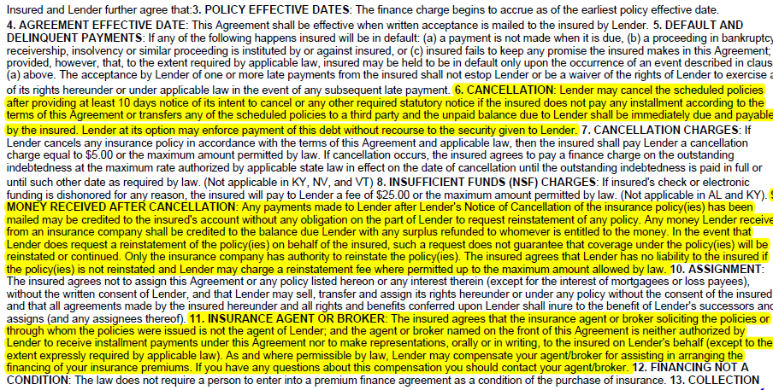
Premium finance agreement

Slide 64
Agreement Highlights
Lender may request cancellation of insurance policies
Lender may proceed to collect the entire unpaid balance due hereunder or any part thereof by appropriate legal proceedings
Money received after cancellation: Any payment received after policy cancellation may be credited to the indebtedness due hereunder without any liability or obligation on the part of the lender to request reinstatement of such cancelled policies
Agent or broker on the front of this agreement is neither authorized by the lender to receive installments payable in this agreement nor is authorized to make representation to insured under lender’s behalf
Notes:
A premium finance company can actually demand payment of the entire balance on a pfa – however, I have never actually seen any finance company do this.
Point #2 – This happens only in rare cases (Audits, retros) where the PF Company knows there will be enough from the Carrier.
We don’t have to request reinstatement! If an insured has canceled, reinstated, canceled, reinstated we might be tempted. If an insured is close to the next due date a finance company may require them to make the additional payment so the insured does not stay behind in his obligations.
On Point above, sometimes the insured sends in the money and it is received by us after the account is cancelled. This money is owed to the lender and the lender has the right to keep it until the account is settled. If the account is reinstated, there is no problem. On the rare occasion the account is NOT reinstated, we have run into problems. As you can imagine, this is rare, but not so rare that it doesn’t behoove the lender to cover it in the PFA.
The lender is not the carrier and can only request reinstatement. Since it is a request, the carrier can decline. This happens if the carrier realized the risk they’ve taken exceeds the risk they’ve calculated. This doesn’t happen often, but when it does, you can imagine the reaction of the insured. They would call you, the agent. They call us. This clause cuts down on the time the agent and the Premium Finance company spend sorting it out when it does happen.
What happens when the carrier does not reinstate? They do not tell the finance company. Remember the pfa is pure financial contract with the insured. Just because it is now current does not mean the policies are in effect. The relationship with the carrier is through the agency therefore, you will know before the finance company the status of the policy. If it has been cancelled you must inform the insured.
Many insureds then want their money back as they think they are going to lose it. They have to remember (and it is usually the agent or the finance company that must remind them) that they still owe this money.
Example: Funds from insured toward pfa credited even if carrier chooses not to reinstate ( $100 bal – insured pmt of $50 – bal now $50 – rp of $80 - $30 credit balance back to insured / $100 bal – rp $80 – insured owes $20) No loss of funds!

Slide 65
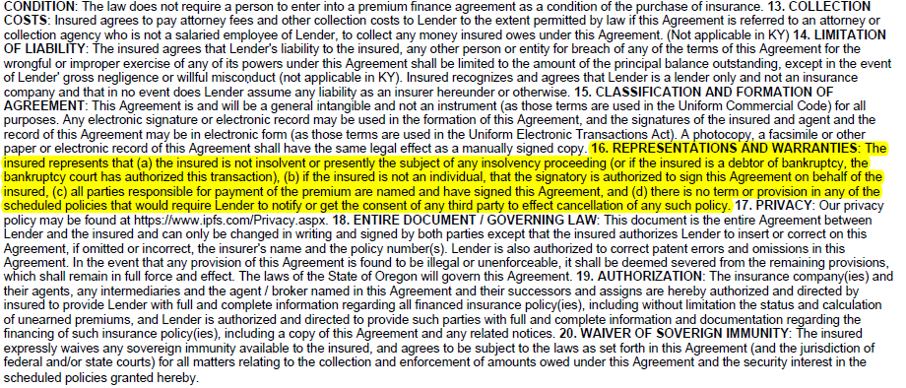
Premium finance agreement

Slide 66
Agreement highlights
Insured’s Representations & Warranties
The Insured is not insolvent or presently the subject of any insolvency proceeding
If so, the bankruptcy court has authorized this transaction
The Insured, if not an individual, the person signing has the authority to sign on behalf of the company
All parties responsible for payment of premium are named and have signed this Agreement

Slide 67
Responsibilities of
Each Party

Slide 68
RESPONSIBILITIES OF
EACH PARTY
Insured
Agent
Wholesaler/Carrier
Premium Finance Company

Slide 69



Insured responsibilities
Repays lender, with interest, the sum the lender advances to pay premium
Assigns to lender, as collateral, the unearned portion of the premiums
Appoints lender attorney-in fact with authority to request the policy be cancelled behalf of the borrower if default occurs
Notes:
Repay the lender – that is the most important thing!!!
Note: We can flat cancel within 30 days of the booking date without the insured having to pay interest. Anything beyond 30 days and we will have to collect interest for the first month. This will differ for each premium finance company.
Our power of attorney is limited to the verbiage contained in the premium finance agreement. It is limited to a request to cancel the policies upon default by the borrower. We cannot cancel the coverage for any other reason. (Review some of the requests we receive from agent to cancel coverage – down payment bounced (agt must request), received Broker of Record, etc.)

Slide 70



Agent responsibilities
Provide premium finance company with accurate, precise, and complete information regarding policy terms and conditions
Collect specified down payment from insured
Inform premium finance company of down payment default

Slide 71
carrier responsibilities
Advise of any inaccurate information contained in the acceptance notice
Process lender’s request for cancellation
Forward unearned portion of the premiums to the lender (usually via the retail agency)
Notes:
We send them a Notice of Acceptance to which they should respond if there are any discrepancies.
Examples of discrepancies: incorrect address for the insured; incorrect premium amount; incorrect effective date, etc. Inaccurate information may/can raise red flags for the lender. Especially if the carrier indicates that they do not have a record of writing a policy for this insured.
Lender expects the carrier to honor their requested date of cancellation. Some carriers will re-notify and add days to the cancellation process.
Premium finance law (in most states) requires the carrier to send the return premium directly to the lender. However, most carriers generally return unearned premiums to the retail agent. We ask the agent to forward the unearned premium to the lender, regardless of the balance owed as we act on behalf of the insured. (There is an official answer and an unofficial answer) Example – agent mistakenly sends the return premium to the insured and the insured does not pay off the pfa – whose responsibility to collect from the insured? The lender or the agent.
You want to make sure that you are dealing with a reputable MGA/Carrier, someone that is financially stable. In the event of cancellation and a RP, their responsibility is to return the dollars. You probably know of many cases where a carrier or general agent has failed to meet these responsibilities. This is a reason why we depend on external rating (Best’s) and an internal staff to grade the carrier.

Slide 72

finance company responsibilities
Send notices required by law:
Notice of Acceptance
Intent to Cancel
Notice of Cancellation
It is not required by law to send a monthly invoice
Return credit balance to the insured withing legally stipulated time frames

Slide 73
Pitfalls and how to avoid them
Know your risk
Collect full down payments
Insufficient down payment check
Avoid collecting insured payments
Educate insured on making payments
Remit return premiums to premium finance company if policy cancels
Notes:
Know your risk – if a deal is unsecured at any point and it cancels, and the Carrier doesn’t reinstate…The PF Co will ask the insured for the balance.

Slide 74
Current premium finance
technology

Slide 75




Current Premium Finance Technology
Online Quoting
24 Hour Account Management System
AP Online Quoting
Agency Branding for Website
& eForms Emails
Payment Options – Online Mobile App & IVR Options
Integrations
eForms
IPFS Connect®
eSign and Down Payment Transactions

Slide 76
LEVERAGING
PREMIUM FINANCING

Slide 77
Leveraging premium financing
BILLING METHODS
Invoice
    Coupon
    ACH
    Recurring Credit Card/ACH
    Credit card one time transaction
MOBILE APP & WEBSITE
Make Payments
Check account status
Update account information
Receive push notifications
PAYMENT OPTIONS
Check by mail
ACH debit from insured bank
Online bank debit from insured
24/7 IVR phone payments (English & Spanish)
Down payments by ACH and credit card*
Notes:
Billing Methods – What is available and how they can be used to the client’s advantage.
Payment Options – Insured Payment Options

Slide 78
Leveraging Premium Financing
Custom Payment Dates
Agency Alert for Pending Cancellation
Email Cancellation Alert to Insured
Hold cancellation
Update Policy Information Online
Interactive Report Options
Multi Location Capability
Agent Messages from Website
Integrations
Policy Preservation Tools
Notes:
Agent Messages from Website: Agency can create announcements for users/insured that can be viewed from website

Slide 79
You Do The Deal

Slide 80
Case Study part one
The following exercise reflects, some but not all variables taken into account when making a decision to finance.
Scenario:
You’ve just won the lottery and have learned that if you invest it wisely, you will live as you prefer for the rest of your life. After much research you’ve decided your best investment is to finance commercial P&C insurance premiums.
ABC Insurance Agency has agreed to try your company and has submitted the options below for financing. Please review and give your quotes for consideration. All potential customers have agreed to pre-set rates. You are in competition with other finance companies for the business but remember this is your money.
Information is provided on each deal regarding the insured past payment history, D&B score, policy provisions, and requested structure. After reviewing the information, please answer the questions associated with each case.

Slide 81
Option Number 1
Company Name: Ace Trucking
Request for: $100,000
D&B rating: 2 (on a scale from 1 to 5 where 1 is the best and 0 = bankrupt)
Years in business: Seven
Type of policies: Trucking
Minimum earned premium: 25%
Cancellation delay: 30 days
Requested structure: 12 equals
History of payment to premium finance lender: Two late payments last year and one the previous year. No cancellations.
Will you extend a loan to this insured? With the requested structure? If not, what structure would you suggest? (Take a guess). What is your rationale for choosing that structure? Is there anything else you would like to see or confirm before you do the deal?

Slide 82
Option Number 2
Company Name: Grisham’s Law Firm
Request for: $100,000
D&B rating: 4 (on a scale from 1 to 5 where 1 is the best and 0 = bankrupt)
Years in business: 17
Type of policies: Professional Liability
Minimum earned premium: 25%
Cancellation delay: 10 days
Requested structure: 10 equals
Will you extend a loan to this insured? With the requested structure? If not, what structure would you suggest? (Take a guess). What is your rationale for choosing that structure? Is there anything else you would like to see or confirm before you do the deal?

Slide 83
Option Number 3
Company Name: ABC Toys
Request for: $250,000
D&B rating: 2 (on a scale from 1 to 5 where 1 is the best and 0 = bankrupt)
Years in business: 4
Type of policies: Workers Comp
Minimum earned premium: 25%
Cancellation delay: 10 days
Requested structure: 12 equals
Considerations: auditable, large deductible or guaranteed cost
Will you extend a loan to this insured? With the requested structure? If not, what structure would you suggest? (Take a guess). What is your rationale for choosing that structure? Is there anything else you would like to see or confirm before you do the deal?

Slide 84
GAME TIME!
FINAL ROUND

Slide 85
GAME RULES
Correct answer = 10 points
You know the rules…

Slide 86
QUESTION #1:
What is the main responsibility of the insured in a Premium Finance Agreement?
Notes:
Repay lender, with interest, the sum the lender advances to pay premium
Assign to l ender, as collateral, the unearned portion of the premiums
Appoints lender attorney-in fact

Slide 87
QUESTION #2:
What is one way to avoid a pitfall?
Notes:
Avoid collecting insureds payments
Educate insured on making payments
Remit return premium to premium finance company if policy cancels

Slide 88
QUESTION #3:
True or False?
The insured appoints the lender power of attorney.
Notes:
True

Slide 89
QUESTION #4:
What is one responsibility of the agent in a premium finance agreement?
Notes:
Provide premium finance company with accurate, precise, and complete information regarding policy terms and conditions
Collect specified down payment
Inform premium finance company of down payment default

Slide 90
QUESTION #5:
What three notices are the finance company required by law to send
Notes:
Notice of Acceptance
Intent to Cancel
Notice of Cancellation

Slide 91
BONUS QUESTION:
20 Points!
What would be two ways to get the most out of your premium finance company?

Slide 92
congratulations!
You have earned two CE credits.
Thanks for joining us!

