Slide 1
Ethics
The Fundamentals of Ethics
Three Hour Continuing Education Webinar

Slide 2
What We Will Cover
What is ethics?
Ethics in business
Ethical to whom?
Fraud
Compliance
State Regulations: Law and ethics

Slide 3
What We Will Cover
Federal consumer protection laws
Making ethical decisions
Professional foundation for insurance ethics
Ethical climate

Slide 4
What is Ethics

Slide 5
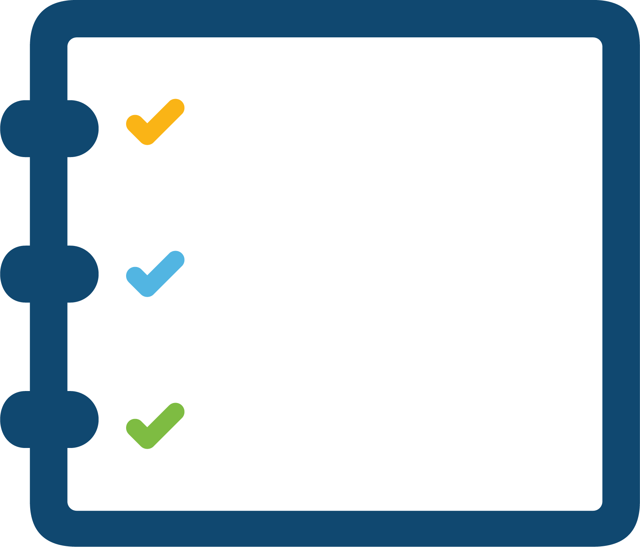
What is Ethics?
The discipline dealing with what is good and bad and with moral duty and obligation.
Merriam-Webster Dictionary Definition:
A set of moral principles; a theory or system of moral values.
The principles of conduct governing an individual or a group.
Notes:
Fully defining ethics is in itself a difficult task. There are many levels of ethical structure, involving varying motivations, scenarios, and concepts. For the insurance agent, it is not as important to know the full scope of ethics as it is to understand how to apply ethics to working relationships.

Slide 6
What is Ethics?
Ethics, by its very nature, is a discipline that takes into account morality and moral principles.
Ethics is how people ought to act in certain situations or with various people.

Slide 7
Ethics vs Morality
Morality is the principle of right and wrong behavior.
Ethics is the practice of such behavior.
Morality defines personality and character.
Ethics is the framework within which morals are applied.
Notes:
1. It is easy to see how we can confuse ethics with morality.
2. Even so, ethics remains difficult to explain. Usually, ethics is confused with socially accepted behaviors, laws, or sometimes even religion. While ethics can be associated with any of these areas, none of them are where ethics is founded.

Slide 8
Morality Vs Ethics
Ethics is:
A code of behavior that can stem from one’s immediate surroundings.
The parameters, developed out of one’s experiences or immediate surroundings, by which one conducts oneself in public settings such as the workplace.
Usually ethics is confused with socially accepted behaviors, laws, or sometimes even religion.

Slide 9
Morality vs Ethics?
Morality is a more personal form of ethics.
One’s own personal code of conduct.
Because ethics is a system of morals, there are commonalities between the two.
Notes:
1. For example, Amy may teach her children not to take things from their siblings’ rooms without asking because, in her mind, that’s stealing. This is a moral lesson that Amy is teaching and it becomes an ethical code, as well as a law, when applied outside her home. Taking other people’s things without asking is considered stealing, according to the ethical code in many societies.

Slide 10
Ethics in Business

Slide 11
Ethics in Business
A business code of ethics attempts to recognize what’s right and wrong around behaviors and to provide structure.
To encourage and deter wrong behaviors.
Companies develop values, mission statements, employee handbooks, training, and other programs and guidelines to define their ethical position and expectations to the public and to the employees.
Notes:
The role of ethics and morality also play a part in the business world. Because morality varies so widely among individuals, ethics become an important component to conducting business. For business, a set of expectations and rules that all employees must follow is vital to the company’s reputation and position both in the business community and with the public.

Slide 12
Ethics in Business
A code of business conduct may include the following:
Principles in personal and professional relations
Relationships with shareholders (stockholders, non-managing owners)
Relationship with employees
Relationship with other business and community organizations
Relationship with government authorities
Proper checks and balances (disclosure and compliance)

Slide 13
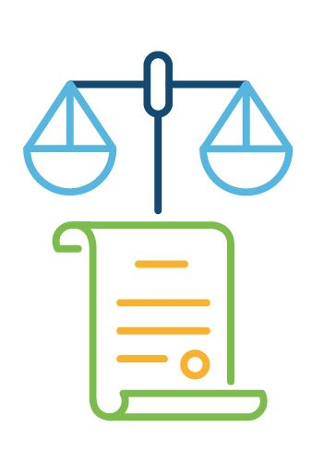
Ethical Difficulties
Yet even with a sound ethical structure in place, companies can get into trouble.
Over the years the news has given us many examples of companies that suffered from ethical difficulties.
Looking at a few of these famous falls from grace can put into perspective ethics and the importance of an ethical structure within a corporate setting.
Notes:
Part of that is a lack of commitment to the ethical codes set forth or a lack of an ethical oversight program or process that ensures these standards are met within all areas of the company. Another factor is that because laws often come with black-and-white interpretations, ethical dilemmas are much more difficult to unravel.
Applications get filed later than required. Mistakes on claims are embarrassing and leave agents wondering the best course of action. It is easy to understand how some ethical boundaries can be crossed given that the laws are applied in real life and involve scenarios that vary and have extenuating, emotional circumstances attached.
Sometimes, though, ethical boundaries are crossed with intent or in cases of oversight or lack of strong governance.

Slide 14
Ethical Difficulties
Enron
In 2001 the most famous example of corporate misdeeds—the Enron scandal—was revealed.
Layers of financial misstatements, conflicts of interest, unethical practices, and questionable accounting practices had led to the overstatement of earnings and the eventual bankruptcy of the company.
Enron did have a code of ethics, which the company titled “Our Values”
Clearly the company did not abide by its own credo. Instead, in at least one case, a senior officer was granted three separate exemptions from the company’s code of ethics in order to create entities for the company from which that officer would personally profit.
Notes:
Here is a statement pulled from Enron’s ethical code, “Our Values”: INTEGRITY: We work with customers and prospects openly, honestly, and sincerely. When we say we will do something, we will do it; when we say we cannot or will not do something, then we won’t do it.

Slide 15
Ethical Difficulties
Joseph Caramadre - Lawyer
In 2013 Joseph Caramdre was sentenced to six years in prison for his role in an investment scheme that recruited terminally ill people to sign over death benefits to passive investors.
After researching variable annuities, Joseph Caramadre found that there was no requirement for the investor and the annuitant or “measuring life” on the policy, to be the same person or even to be related. He exploited that loophole for himself and his clients so that they could reap the rewards of the variable annuity without having to die.
“All we need to do is replace the necessity of the investor having to die, with someone else dying.”
In interviews Caramadre said the companies designed the rules; all he did was exploit them.
Prosecutors allege that Caramadre and his accomplices fraudulently obtained $15 million from insurance companies.
Notes:
1. Put simply Joseph Caramadre was setting himself and his clients up to profit from the demise of strangers.
2. There have been at least eight lawsuits there were filed in Rhode Island relating to Caramadre’s scheme. Insurance Companies Nationwide, Transamerica, and Western Reserve all have sued.

Slide 16
Ethical Difficulties
Why do people act unethically?
Greed, stress, different value standards.
Time constraints – emphasis on productivity and profit.
Wall Street Journal poll – 65% of executives surveyed agreed that managers today feel under pressure to compromise personal standards to achieve corporate goal.

Slide 17
Lessons Learned
It would be nice to say that corporate America has learned from its mistakes. However, because corporations are made up of people with varying moral codes, the instance of corporate scandal involving ethical offenses will continue.
What companies can do, however, is take those lessons learned by companies that have been unwillingly put into the spotlight and establish, reinforce, or renew efforts to ensure the code of ethics is understood by everyone from ownership throughout the company.

Slide 18
Ethical to Whom?

Slide 19
Ethical to Whom?
Ethical standards play an important part in business decisions. It is important to know in the insurance industry whom he or she must answer to:
The Public
Companies Represented
Clients
Other Agents

Slide 20
The Public
Agents have a responsibility to the public in interactions and must uphold an honest trustworthy reputation within society.
Honest representations in all communications
Honest solicitation of business
Amicable and cooperative relationships among agents
The Public

Slide 21
The Companies Represented
Agents are expected to accurately and honestly represent the products and services of the companies they represent.
Companies expect agents and agencies to operate under good corporate governance.
Companies Represented
Notes:
That includes communicating with the insurance companies to ensure the companies’ expectations are being met and to foster a more collaborative environment. Honestly representing products and services is a paramount concern for agents, and agents must be cognizant of how their communications and actions affect the insurance companies’ interests and reputation.
Agents should abide by all codes of conduct set forth by the agency and, lacking such codes, should work toward creating and helping maintain sound business practices.

Slide 22
Clients
Clients deserve accurate, complete information from insurance agents.
Agents are expected to provide appropriate product recommendations and guidance to clients.
Clients need to know that information they share with the Agent will be handled with the utmost care to ensure privacy.
Clients
Notes:
Agents need to service their clients’ policies diligently and making sure any important information or policy changes are communicated to the clients in a timely manner.

Slide 23
Other Agents
The goal of agents working within the industry should be:
To collaboratively work to ensure the integrity and proper behavior of all agents by encouraging adherence to the law and to insurance industry standards.
Have a fiduciary responsibility to their insurers.
Act in the best interests of the insurer and must account for premiums collected.
Other Agents
Notes:
As colleagues within an industry, agents are expected to carry on their relations with other insurance agents and agencies in the spirit of positivity. Despite being business competitors in many instances, agents are all part of the same industry and want the same things for their clients and their insurance companies.
Agents in many states work under the “contract of agency” arrangement, which creates the fiduciary relationship.

Slide 24
Ethical to Whom?
Edward M Breight, CPCU – CPCU Journal Article Survey (2005).
CPCU Society members were asked to rank 32 ethical issues facing the insurance industry from most to least important:
Failure to identify the customer’s needs and recommend products and services that meet those needs.
Lack of knowledge or skills to competently perform one’s duties.

Slide 25
Ethical to Whom?
What do you feel are the top three ethical issues facing the insurance industry today?
1.
2.
3.

Slide 28
Question #1
True or False?
The Merriam-Webster Dictionary defines ethics as: The discipline dealing with what is good and bad and with moral duty and obligation.
Notes:
Answer: True

Slide 29
Question #2
Ethics is:
A code of behavior
Developed out of one’s immediate surroundings
It is not a code of law
Or all of the above
Notes:
Answers: D – all of the above

Slide 30
Question #3
True or False?
Morality is the principle of right and wrong behavior.
Notes:
Answer: True

Slide 31
Question #4
In the insurance industry who does the agent answer to?
The public
Clients
Other agents
All the above
Notes:
Answer: All the above

Slide 32
Question #5
True or False?
Agents are expected to accurately and honorably represent the products and services of the companies they represent.
Notes:
Answer: True

Slide 33
Question #6
Agents must act in the best interest of whom?
Notes:
Answer: Clients, The Public, Companies Represented, Other Agents.

Slide 34
Question #7
True or False?
Ethics is the framework within which morals are applied.
Notes:
Answer: True

Slide 35
Question #8
Name one expectation a client might have from an insurance agent.
Notes:
Answer: 1. To provide appropriate product recommendations.
2. The information shared will be kept confidential.

Slide 36
Question #9
How should the agent honor the public’s trust?
Notes:
Answer: By complying with all the state regulatory standards.

Slide 37
Question #10
Companies expect agents and agencies to operate under good ____?
Notes:
Answer: Corporate governance

Slide 38
Fraud

Slide 39
Fraud
Merriam-Webster:
Fraud is “an act of deceiving or misrepresenting”
What is fraud?
Or an intentional pervasion of the truth with the intent to deceive

Slide 40
Fraud
The total cost of insurance fraud is estimated to be more than $40 billion per year. *
Insurance fraud costs the average U.S. family $400-$700 per year in increased premiums.
4% of the money the insurance industry makes is lost to insurance fraud.
*Article from Insurance Fraud - FBI

Slide 41
Fraud
In the insurance industry, fraud can be broken down into two distinct areas.
Hard
Fraud
Soft
Fraud

Slide 42
Hard Fraud
A deliberate, planned attempt to falsify information or withhold information for the express purpose of financial gain for either the agent or the client.
Hard
Fraud

Slide 43
Hard Fraud
Examples of hard fraud:
Over-insuring a property for an amount greater than the property’s value.
Claiming higher losses on claims than those actually suffered.
Claiming theft of items that were actually damaged or lost.
Selling clients unnecessary coverage.

Slide 44
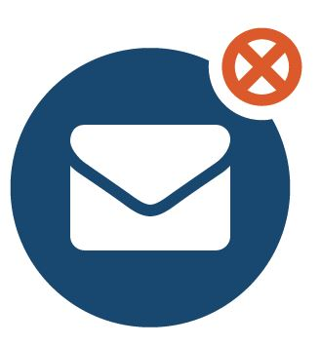
Examples of Hard Fraud
In a recent case, an insurance agent was charged with mail fraud for receiving nearly $168,000 in premiums on policies that didn’t exist. The agent accepted payment for eight years on phony policies.*
John has been unemployed for several months, when his old clunker car breaks down. Desperate for money to replace his car, John decides to make it look like someone broke into his house, then made a police report claiming theft of several expensive items.
*San Francisco Chronicle. 2013

Slide 45
Hard Fraud
Hard fraud is one of the reasons insurance companies have insurance fraud investigators.
Hard fraud cases almost always result in felony charges.
Hard insurance fraud is common.
Hard
Fraud

Slide 46
Soft Fraud
Soft fraud is the “white lie” concept of withholding important information or embellishing facts in order to financially benefit.
It is usually unplanned and arises when the opportunity presents itself.
This is the most common form of insurance fraud and the most difficult to detect because it usually has a large element of truth to it.
Soft
Fraud
Notes:
So far, all examples given have echoed typical hard fraud situations. However, there is a more subtle form of fraud—one that takes advantage of opportunity—that agents and policyholders commit with much more frequency. Soft fraud is just as intentional as hard fraud, but it lacks the preplanning aspect of hard fraud

Slide 47
Soft Fraud
Examples of soft fraud:
Exaggerating claims that would otherwise be legitimate.
Claiming injuries are more severe than they are.
Claiming stolen property is worth more than it is.

Slide 48
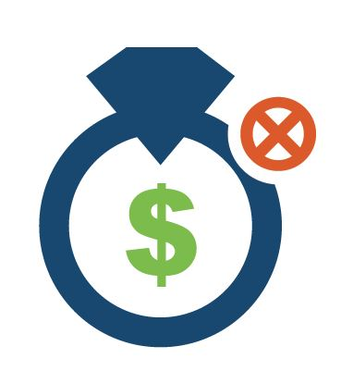
Examples of Soft Fraud
Mary has lost her expensive ring. When she files the claim, she tells her agent that the ring really only cost $500 to replace but since this was given to her by her deceased grandmother it should have much more sentimental value and would like to get $1,000 for it. Agent, seeing an opportunity to earn a little spending money, files a claim on Mary’s behalf, bumping up the value of the ring to $1,200. She then pockets the extra $200 without telling Mary.
Both Mary and the agent have just committed soft fraud.
Notes:
1

Slide 49
Fraud
Whether the fraud is planned or the result of an opportunity, it is against the law and in direct violation of all corporate, association and legal ethical standards.
It is also a direct violation of the regulatory requirements set by the industry and by each state’s insurance commission.

Slide 50
Compliance

Slide 51
Compliance
Accountability and compliance are very much an agent’s responsibility.
Agents are responsible for staying up-to-date on current regulations, changes in regulation, and what is required of them in order to maintain compliance.
Notes:
There was once a time in the insurance industry history when agents would operate with autonomy and with minimal insurer supervision. They were relatively free to conduct their relationships with clients. No more. As insurance regulators have put pressure on insurers to comply with stricter regulations, they have also placed similar expectations on agents.
Insurers have imposed their own ethical standards on agents. In most cases, those standards include the expectation that agents will meet all necessary compliance requirements and will conduct themselves in a legal and ethical manner. For that reason, many insurers have provided compliance department assistance to agents and independent agents. However, ensuring compliance is not the responsibility of the insurer.

Slide 52
Compliance Example:
Jenny’s client Tim filed a claim for damages his business sustained during a wind storm. Jenny receives his claim on a Monday morning but waits until Friday to file the claim with the insurer, reasoning that her other clients will be filing similar claims, and she would rather file them at the same time to save herself some time.
However, the insurance commission in Jenny’s state requires that agents file all claims within 24 hours of receiving them.
Jenny is in violation of state regulations.

Slide 53
Compliance
Ten Most Common Market Conduct Compliance Issues for P&C
1. Failure to pay the appropriate claim amount
2. Failure to acknowledge, to pay, or deny claims within specified time frames
3. Failure to non-renew policies in accordance with requirements
4. Using unapproved forms, unfiled rates and/or misapplication of rating factors
5. Failure to provide required disclosures in claims process
6. Failure to adhere to producer appointment, termination and/or licensing requirements and adjuster licensing requirements
7. Failure to cancel policies in accordance with requirements
8. Failure to respond to the Department of Insurance and/or produce records requested during the exam process
9. Failure to adhere to underwriting rules and/or provide required disclosures
10. Improper documentation of claim files
* Source: Wolters Kluwer Financial Services

Slide 54
State Regulations: Law and Ethics

Slide 55
State Regulation: Law and Ethics
When there are gray areas in which agents face difficult decisions, there are laws that can help guide them.
But make no mistake, laws represent the minimum standard by which agents should conduct their business.
They provide clear lines between “can and cannot”, but not so distinct with the issue of “should and should not.”
Ethics go beyond the minimal standard to promote optimal behavior.
Ethical behavior recognizes and abides by the spirit of law, not just the law itself.
Notes:
This section we will talk about the various laws, written and unwritten, that govern the insurance agent’s actions and business dealings and can be used as a guide for minimum standards for ethical behavior. From regulations to unspoken agreements, agents are acting as representatives of their clients and their insurance companies.
Whether acting as an independent agent or in a more direct relationship with the insurer, an agent is expected to follow rules and regulations that apply to all interactions with clients and relations with the insurers themselves. Following these rules and regulations is the baseline for ethical decision-making; however, they are only one of several guides that can be followed.

Slide 56
State Regulation: Law and Ethics
States take the lead in creating ethical behavior.
Individual states are responsible for the ethical behavior of the agents doing business within their borders.
States have established guidelines of expected behavior and in some cases have adopted the laws set forth by the NAIC.
The NAIC is a repository of regulatory information, market analysis, and educational resources for state commissioners and members.
Notes:
.

Slide 57
NAIC Mission Statement
The mission of the NAIC is to assist state insurance regulators, individually and collectively, in serving the public interest and achieving the following fundamental insurance regulatory goals in a responsive, efficient and cost effective manner, consistent with the wishes of it’s members:
Facilitate the fair and equitable treatment of insurance consumers
Support and improve state regulation on insurance
Protect the public interest
Promote the reliability, solvency and financial solidity of insurance institutions
Promote competitive markets
*Source: National Association of Insurance Commissioners
Notes:
.

Slide 58
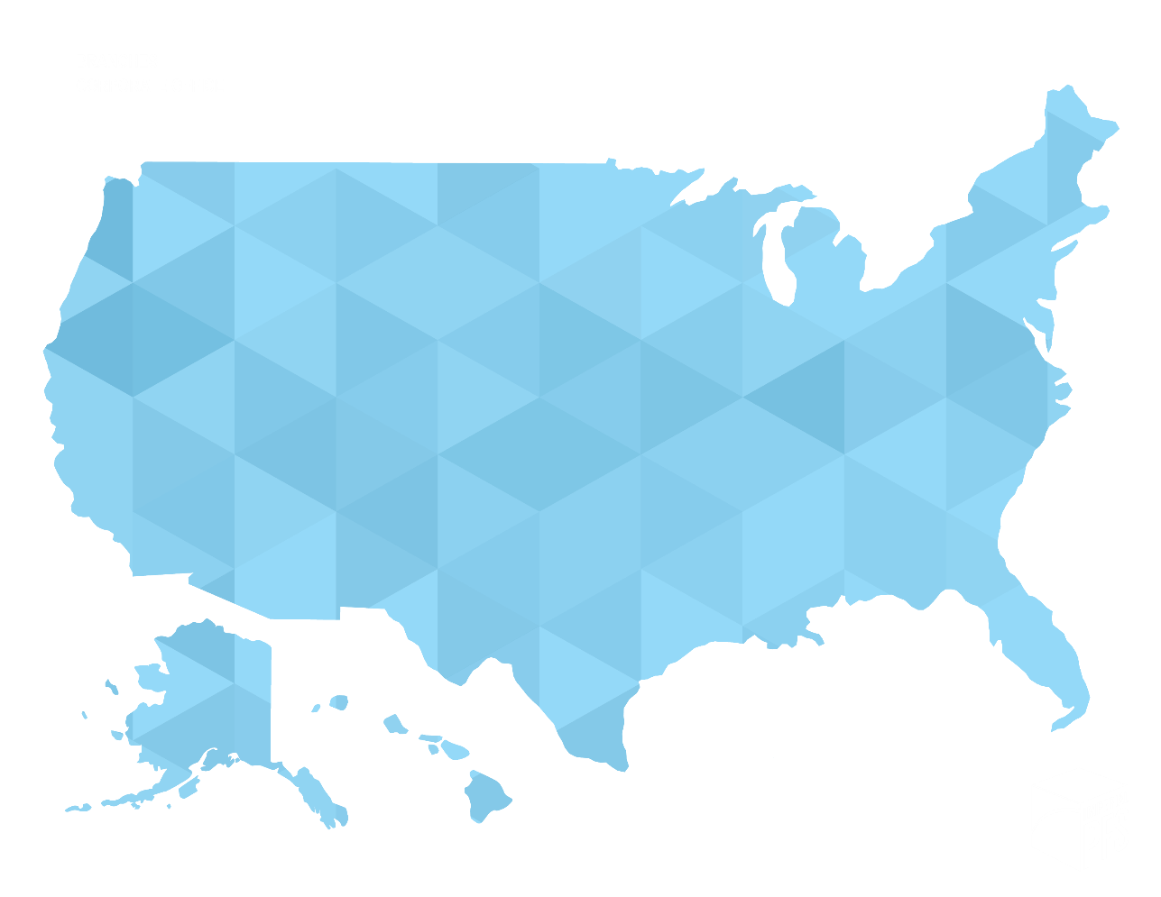
NAIC
The NAIC uses model laws which are presented to each state legislature; such models help insure the uniformity among state laws that work to the benefit of an industry which crosses state lines.
Notes:
1. Insurance commissioners in each state are charged with investigating claims of unethical or unlawful behavior; overseeing the issuance of licenses; levying penalties for violations of ethical practice – penalties may include fines, or the suspension or revocation of the agent or company to do business in that state; and seeing to it that penalties are carried out.

Slide 59
State Regulations
State requirements:
Agents must be fully licensed to sell and service insurance policies
Continuing education
The amount of hours vary by state
Financial regulation of insurance
Insurers doing business in a state are required to be licensed in that state.
Insurance products
States require that policy provisions are reasonable and coverage is adequate and easy to understand
Market level
Pricing
Products
Trade practices
Notes:
1.While each state has its own unique set of laws and regulations governing the sale and service of insurance products, some laws are requirements in every state. For example, every state requires agents to be fully licensed to sell and service insurance policies. States also require continuing education, which varies per state, to ensure that all agents are serving their customers, insurers, and industry with the highest level of professionalism.
2. State regulators also oversee the financial regulation of insurance. Insurers doing business in a state are required to be licensed to do business in the state. They are also required to file quarterly and annual financial reports. Also, states conduct periodic examinations of financial records, accounting methods, and processes to ensure the insurer’s financial well-being.
3. Also covered under state regulation are the insurance products themselves. States require that policy provisions are reasonable and that coverage is adequate and easy to understand. In the case of personal lines property and casualty coverage, states require rate review and approval.
4. Another area in which states regulate the insurance industry is at the market level. Regulations designed to protect the consumer’s interests involve pricing, products, and trade practices. Regulators will review the market conduct regularly to ensure compliance by both agents and insurers. Both are expected to live up to the letter of the law, as well as its spirit.

Slide 60
State Regulation
States are charged with enforcing laws that protect the insurance industry. The insurance commissions carry out specific duties, including:
Establishing and enforcing regulations
Overseeing agent, broker, and insurer licensing
Reviewing insurance company financial positions
Reviewing and approving insurance rates and form filings
Influencing lawmaking at state and federal levels
Regulating advertising and marketing practices

Slide 63
Question #1
What is fraud?
Notes:
Answer: 1. Merriam Webster Dictionary: “An act of deceiving or misrepresenting.”
2. Or an intentional pervasion of the truth.

Slide 64
Question #2
Name two types of insurance fraud.
Notes:
Answer: Hard Fraud, Soft Fraud

Slide 65
Question #3
What is the estimated cost of insurance fraud per year?
Notes:
Answer: 40 billion

Slide 66
Question #4
What is hard insurance fraud?
Notes:
Answer: The deliberate planned attempt to falsify information or withhold information for the express purpose of financial gain.

Slide 67
Question #5
Give an example of soft fraud.
Notes:
Answer: 1. Exaggerating claims that would otherwise be legitimate
2. claiming injuries are more severe than they are
3. Claiming stolen property is worth more than it is

Slide 68
Question #6
True or False:
Ethics are directly under federal control.
Notes:
Answer: False

Slide 69
Question #7
What is the mission of the NAIC?
Notes:
Answer: To assist state insurance regulators

Slide 70
Question #8
True or False:
Individual states are responsible for the ethical behavior of the agents doing business within their borders?
Notes:
Answer: True

Slide 71
Question #9
Accountability and compliance are whose responsibility?
Notes:
Answer: Agent

Slide 72
Ethical Discussion

Slide 73
Ethical Discussion Part One
Take a look at the scenarios provided and analyze the ethics of the actions.

Slide 74
Discussion 1
What would you do if you had the opportunity to quote an account or write a type of insurance coverage for which you are licensed, but you have very little knowledge to assist the client in identifying and evaluating their needs and coverages required to provide proper protection?
Is there ever a situation when you feel that you would decline to write an account?

Slide 75
Discussion 2
One of your long time client’s premium continues to increase every renewal period. The carrier states the reason for the increase is due to the type of business being unprofitable every year. A friend of your happens to work for the competition and you know they offer a comparable product that is more affordable. Should you continue to try your best to retain the client or refer them to you competitor?
Would your decision be helped by knowing the competitor offered to pay you a referral fee or to reciprocate with clients or prospects in similar situations?

Slide 76
Discussion 3
You have a very difficult client that makes your job a bit more stressful. You would be much happier if they took their business to another agent.
Their renewal is coming up and because of an re-evaluation of their policy their renewal premium will increase by 10%.
You represent another carrier that uses a guide that is much more conservative. If you move the client to this carrier it would keep the client’s policy premium the same as it was the previous year or even lower it.
Your clients informs you if their premium is not reduced they will have to look for another agent.
What would you do?

Slide 77
Federal Consumer Protection Laws

Slide 78
Federal Consumer Protection Laws
To date, there is no optional federal oversight available, though not for a lack of trying.
The proposed National Insurance Act of 2006 floundered but was followed quickly by the National Insurance Act of 2007, also not able to make a lasting impression.
Over the decades a number of laws have been enacted to cover areas on insurance regulation not covered by the state regulatory departments.
Notes:
For decades, there has been a push to nationalize insurance regulation. Proponents of placing regulation of insurance in the hands of the federal government believe that one body overseeing the business of insurance would streamline filing, simplify the process of doing business in more than one state, and bring much-needed relief from a conflicting, complex state regulatory landscape. A movement started in a climate of insurer insolvency and capacity issues in the 1970s, the proposal has been to implement an optional federal charter. The idea had renewed interest in the mid-1980s, when insolvencies were occurring again, and once more in the 2000s, when investigations into the finances of insurance companies uncovered unethical behavior.

Slide 79
Federal Consumer Protection Laws
Sherman Antitrust Act of 1890: The first of its kind, it prohibits anticompetitive business activities and gives the federal government authority to investigate and deal with companies, organizations, and trusts believed to be in violation.
Clayton Antitrust Act of 1914: This Act gave more teeth to the Sherman Act by attempting to thwart anticompetitive behavior at the earliest stages. The Act stated specific illegal conduct, exemptions, enforcement measures, and remediation.
Federal Trade Commission Act of 1914: Establishes an appointed membership charged with restricting unfair trade practices of large corporations.
McCarran Ferguson Act of 1945: Exempts insurance business from federal regulation (with some exceptions), including limiting the extent that federal antitrust laws apply.
Notes:
For decades, there has been a push to nationalize insurance regulation. Proponents of placing regulation of insurance in the hands of the federal government believe that one body overseeing the business of insurance would streamline filing, simplify the process of doing business in more than one state, and bring much-needed relief from a conflicting, complex state regulatory landscape. A movement started in a climate of insurer insolvency and capacity issues in the 1970s, the proposal has been to implement an optional federal charter. The idea had renewed interest in the mid-1980s, when insolvencies were occurring again, and once more in the 2000s, when investigations into the finances of insurance companies uncovered unethical behavior.

Slide 80
Federal Consumer Protection Laws
The federal government’s control over insurance really lies within laws that are uniform across all states.
Medicare Supplement
Long term care
Insurance programs for cases in which insurers are unable or unwilling to insure (such as federal flood, federal crime, federal crop and the fair access to insurance requirements plans). For these cases the federal government is the property insurer or last resort, should coverage not be obtainable elsewhere.
Once again, these laws can help guide ethical decision making but does not define ethical behavior.

Slide 81
NAIC
The NAIC has stepped in where laws are vague or not specific enough to the insurance industry and created hundreds of guidelines, frameworks, and model laws for individual states to adopt.
Some of the more notable standards to come out of associations include the following:
Unfair Trade Practices Act
Statutory Accounting Principles
Insurance Fraud Prevention Model Act
Long-term Care Model Act
Producer Licensing Model Act

Slide 82
Unfair Trade Practices Act
This act prohibits many practices regarding insurance policies including false information and advertising, defamation, coercion, and intimidation.

Slide 83
Statutory Accounting Principals
Accounting rules that help states regulate insurance company solvency. They also help insurance companies prepare statutory financial statements.

Slide 84
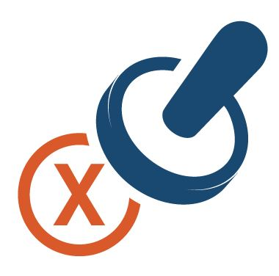
Insurance Fraud Prevention Model Act
Designates the insurance commissioner of each state as expert in investigating, halting, and enforcing fraudulent insurance acts.

Slide 85
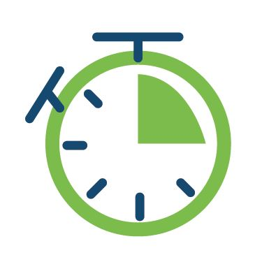
Long Term Care Model Act
Establishes standards for long-term care insurance and promotes development efforts of long-term care insurance product coverage.

Slide 86
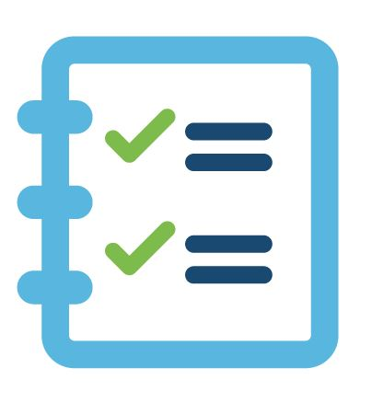
Producer Licensing Model Act
Outlines the qualifications and procedures for the licensing of insurance producers with the exception of surplus lines brokers and agents except where mentioned in the Act.

Slide 87
Federal Consumer Protection Laws
While they do not define the term ethics, laws and regulations exist to help states and the federal government enforce expected actions and company practices that comply with standards of ethical behavior.
Ethical behavior, from a regulatory standpoint, is a vital part of an insurance agent’s role and the agent’s relationship with and responsibilities to insurers, customers, and others in the insurance industry.

Slide 88
Making Ethical Decisions

Slide 89
Making Ethical Decisions
Understanding ethics in theory is much easier than handling real ethical situations.
Some ethical missteps occur when agents are trying to please clients or when they are simply conducting business, unaware that their actions are unethical or in violation of various laws or codes of ethics.

Slide 90
Making Ethical Decisions
Ethical decisions come about from a number of different perspectives, but most ethical decisions fall into one or more of these categories:
Situation based
Rule
based
People
based
Duty
based
Notes:
Even when making ethical decisions, agents do not have a straight path to the right choice. Because there are different positions from which an agent is making that decision, the response will vary based on the factors involved in that particular circumstance. Two people holding the same values and level of honesty can come to two very different conclusions.

Slide 91
Situation Based
This is an ethical decision that is reached through considering each situation and its unique circumstances and nuances.
Allows for contemplation and thinking through the consequences.
Notes:
Decisions are made by considering each circumstance. Right or wrong is weighed at the moment, and in each situation, the decision could be entirely different based on the factors involved.
This is considered the most flexible approach to applying ethics, situation-based ethical decisions allow for contemplation and thinking through the consequences.

Slide 92
Situation Based
In 1960 Joseph Fletcher, a professor at the Episcopal Theological School in Cambridge, MA developed an ethical theory that morality is best abandoned to the most loving actions in a situation.

Slide 93
Situation Based
Fletcher developed four presuppositions that are part of any situational dilemma.
Pragmatism: The course of action must be practical and work.
Relativism: All situations are always relative; situational ethics try to avoid such words as “never” and “always”.
Positivism: The whole of situational ethics relies upon the fact that the person freely chooses to believe in agape love described by Christianity.
Personalism: Whereas the legalist thinks people should work to laws, the situational ethicist believes that laws are for the benefit of the people.

Slide 94
Situation Based
There is a definite downside to this approach. The decision is being made in the moment.
Weighing only the factors that apply today, makes it hard to determine the effects of the decision over a long period of time.
Notes:
Also, there may not be enough factors to allow for a clear, concise decision. There is also a chance that one’s desired outcome could be inserted into the decision-making process, which could alter the results of the decision.

Slide 95
Situation Based - Example
Insurance agent Andy has recently found out that his friend Ryan’s father, who bought a life insurance policy through him, has passed away suddenly. Ryan’s family has told everyone that he had a heart attack, but the fact is that he committed suicide. Andy knows that the policy is void due to the suicide, but he knows Ryan’s family. Ryan’s parents were going through a bankruptcy, and while they had recently managed to get approved for public assistance, it wasn’t enough to sustain the family. Ryan’s mother has congestive heart failure and cannot work, and his father was working two minimum-wage jobs. Andy knows that without the life insurance settlement, Ryan’s mother will be destitute. He decides not to mention the suicide to the insurance company.
Andy’s decision to abandon ethical standards in order to show love and compassion to his friend is commendable. It’s also considered fraud, and both Andy and Ryan’s family could face penalties, including jail time, should the fraud be detected.

Slide 96
Rules Based
Uses laws, regulations, and policies as the foundation for ethical decisions.
What is the right thing to do per the rule that applies in that situation?
Notes:
What is the right thing to do per the rule that applies in that situation? With rules-based ethics, the law is absolute. Because decisions are made from that standpoint, it simplifies the decision-making process.

Slide 97
Rules Based
This may seem to be the smartest approach, however there are a few flaws:
The law may not reflect the current condition
Every law in place today was enacted yesterday, or before
Rules based decisions rely on the laws being valid.
Not all laws are valid, and there are situations that are not ruled by law that could be further damaging in some way.
Notes:
2.

Slide 98
People Based
Golden Rule of decision making. Do unto others as you would have them do unto you.
The idea is to maximize the benefits of one’s actions while minimizing any negative effects.
Notes:
Putting people first in one’s decision-making process seems the way to go. That is the thinking behind people-based ethics. If one is considering how one’s decisions affect others, one is sure to come to the right decision, no?

Slide 99
Duty Based
Deontology is an ethical theory that used rules to distinguish right from wrong.
This theory was first expressed by the 18th century philosopher Immanuel Kant.
Kant felt that reason and experience combined created a more reasonable approach to solving ethical dilemmas.
Notes:
Kant believed that ethical decisions follow universal moral laws such as “don’t lie, don’t steal, don’t cheat.
Deontological ethics holds that everyone has certain duties that they have to fulfill, and that fulfilling these duties is a moral requirement, independent of any considerations about virtue or consequences

Slide 100
Duty Based
Deontology is simple to apply. It just requires that people follow the rules and do their duty.
This approach tends to fit will with our natural intuition about what is or isn’t ethical.

Slide 101
Duty Based
Despite its strengths, rigidly following deontology can produce results that many people find unacceptable.
For example, suppose you’re a software engineer and learn that a nuclear missile is about to launch that might start a war. You can hack the network and cancel the launch, but it’s against your professional code of ethics to break into any software system without permission, and it’s a form of lying and cheating. Deontology advises not to violate this rule. However, in letting the missile launch, thousands of people will die.
So, following the rules makes deontology easy to apply. But it also means disregarding the possible consequences of our actions when determining what is right and what is wrong.

Slide 102
Making Ethical Decisions
What are some of the motivations to being ethical?
Social responsibility, social expectations.
Avoidance of public criticism.
Avoidance of government regulation.
Enhance your credibility with clients and insurance companies.
Being ethical is not a question of just knowing what is right or wrong, it is a matter of doing what is right.

Slide 103
Professional Foundation for Insurance Ethics

Slide 104
Professional Behavior
As a rule of thumb, if it feels wrong, it probably is.
Be careful, careless practice could lead to unethical and then illegal practice.
Notes:
Throughout this course we have been presenting both guidelines and laws regulating ethical practice in the insurance profession. It is important that you realize how fine the line is between unethical behavior and illegal behavior:

Slide 105
Professional Behavior
A professional individual has a commitment to high ethical standards, being careful to avoid any practice of behavior which violates the code of the profession as well as his or her own personal ethical code.
A professional individual:
Has a concern for the welfare of others which transcends concern for his or her own welfare when engaged in the practice of the profession.
Understands the need for mandatory licensing and training, and knows that continuing education in the field is essential if he or she is to serve the public with skill and competence.
Notes:
1. It has become increasingly aware that just to say you are a professional is not enough. We must also behave in a professional manner. The public expects certain things of those who call themselves professionals.

Slide 106
Professional Behavior
A professional individual:
Is normally a member of a professional association or society which encourages high ethics, education, and competence among its members.
Has the ability to act with objectivity and integrity, and does so act in all professional activities.

Slide 107
Ethics in Professional Area
Every Member of the Independent Insurance Agents & Brokers of America, Inc. (IIABA), is expected to follow IIABA’s Code of Ethics, which states in part:
I support the Independent Agency System, which has developed insurance to be a fundamental component in the economic fabric of our nation, and I pledge to support right principles and oppose bad practices in the insurance business.
Within other professional associations in the insurance industry, there is a similar code of ethics:
Canons of Conduct for CPCU
CIC Standards of Conduct
Notes:
These standards enhance the regulatory standards required by companies by setting for all employees personal responsibility, accountability, and behavioral benchmarks. Because of the differences in business models, goals, and expectations, most companies and associations create their own ethical standards and expect agents to comply.

Slide 108
Ethics in the Professional Area
Characteristics of Ethical Principles
1. Honesty – is the basis of ethics
2. Integrity
3. Keeping promises – being reliable and trustworthy
4. Fidelity and loyalty
5. Fairness
6. Personal responsibility and accountability – courage to do the right thing even when others may disagree with your actions
7. Caring and compassion – consideration of the need of others
8. Respect for others – carry out responsibilities
Notes:
Quote from Mark Twain “Always do right. This will gratify some people, and astonish the rest.”

Slide 109
Ethical Climate

Slide 110
The Ethical Climate
Agents get ethical guidance not merely from laws, training, or insurance commissions; their work environment plays a primary role in how they approach and solve ethical situations.
Often, agents get their behavioral cues from their colleagues or their supervisors.
Management has a responsibility to promote ethical practices within the business.
Ethical standards are best adhered to when all members of an organization are responsible for enforcing company ethics policies.
Notes:
No matter what perspective agents use to make ethical decisions, one cannot discount the power of suggestion.
If an agency prides itself on the ethical values and honesty its agents bring to every transaction and interaction, and the management enforces those values, agents are more likely to develop a good process for handling ethical problems.

Slide 111
The Ethical Climate
Driving business ethics in the workplace does more than motivate and inspire everyone within the organization. It has a way of paying back the company.
Ways in which an ethical culture can benefit a company include:
Increased Teamwork and productivity
Stronger management standards
Improved compliance
A better public reputation
Decreased illegal activity
Increased cost savings overall
Notes:
Increased teamwork: When employees know what’s expected of them and what the company’s values are, it makes it easier for them to conduct business in a way that helps the company meet its objectives.
Stronger management standards: When a company is following its code of conduct regularly, management standards improve across the board. Decisions become easier, and companies avoid unnecessary difficulties that arise from not following a strict code of ethics.
Improved Compliance: By building ethical codes of conduct that adhere to the letter of the law, companies can greatly reduce incidents of noncompliance, including any associated fines or penalties.
Better public reputation: People love a company with a heart. Companies with strong ethical standards that are clearly visible in how they do business attract positive attention. Customers want to be part of that culture and want to experience the positivity firsthand.
Decreased illegal activity: Employees who are trained in ethical practices and who have accountability for their actions are less likely to do harm to their employers. While a strong ethical environment will not remove all illegal activity from a company, it will help business greatly reduce the likelihood of an employee committing a criminal act.
Increased cost saving overall: Inspired employees are loyal employees. Ethical cultures with a transparency from the top down breed job satisfaction and employee retention. That saves money in terms of rehiring and retraining. Also, cost savings can be realized with the increased sales and customer retention. When customers trust a company, they stay with a company.

Slide 114
Question #1
How can ethical missteps occur?
Notes:
Answer: trying to please clients or simply conducting business unaware that their actions are unethical

Slide 115
Question # 2
What is a good rule of thumb to follow when making ethical decisions?
Notes:
Answer: If it feels wrong, it probably is

Slide 116
Question #3
Name one of the four categories that making an ethical decision falls under:
Notes:
Answer: Situation based, rule based, people based, duty based

Slide 117
Question #4
Name another one of the four categories that making an ethical decision falls under:
Notes:
Answer: Situation based, rule based, people based, duty based

Slide 118
Question #5
True or False?
The NAIC has stepped in where laws are vague or not specific enough to the insurance industry
Notes:
Answer: True

Slide 119
Question #6
Which of the following standards come from the NAIC?
Federal Trade Commission Act
Producer Licensing Model Act
McCarran Ferguson Act
Notes:
Answer: (B) Producer Licensing Model act

Slide 120
Question #7
True or False:
Situation Base is a method of using laws, regulations and policies as the foundation for ethical decisions?
Notes:
Answer: False

Slide 121
Question # 8
What is the golden rule of decision making?
Notes:
Answer: Do unto others as you would have them do unto you.

Slide 122
Question #9
A professional individual has which trait?
A commitment to high ethical standards
Has a concern for the welfare of others
Both a & b
Notes:
Answer: C – both A & B

Slide 123
Question #10
True or False:
A professional individual understands the need for mandatory licensing, training, and continuing education classes?
Notes:
Answer: True

Slide 124
Bonus Question: 20 Points!
Name one way in which an ethical culture can benefit a company?
Notes:
Answer: 1. Increased teamwork
2. Stronger Management standards
3. A better public reputation
4. Improved Compliance
5. Decreased illegal activity
6. Increased cost saving overall

Slide 125
Ethical Discussion

Slide 126
Ethical Discussion Part Two
What would you do?

Slide 127
Discussion 1
During a company hosted CE course on ethics, you sit next to one of your oldest industry friends, who happens to be one of your biggest competitors as well. During a break, he confides to you that he’s not having a good year. The soft market is crushing any potential revenue growth, he’s lost three of his markets due to volume requirements and his lead CSR just left him to take a job with a premium finance company. His saving grace is the “White Elephants R Us” account he’s had for several years. If he can keep the renewal he may be able to weather the storm.
You know this account well and are supposed to present your proposal, which offers better coverages at a lower price next week. Business has been good to you over the past five years and you hope to wrap this deal up and head to the Bahamas for a much deserved vacation. What do you do?

Slide 128
Discussion 2
You insure a small contractor that has always had a minimum premium liability contract. This year he bid and won several city contractors jobs and his payrolls have increased dramatically.
Although you have had several discussions with him regarding the policy being subject to audit at the end of the year he doesn’t seem to get it.
The policy year ends and three months later, the company has still not requested an audit. You e-mail the underwriting (figuring it’s just a paper back up) and are informed they’ve decided auditing accounts of this size are typically non-revenue generating therefore, they’re closing their file. What do you do?

Slide 129
Discussion 3
It’s 5:00 on Christmas Eve and you’re wondering why you’re still at work when one of your commercial trucking accounts calls. He lets you know he was just notified that the premium finance company has requested cancellation due to non-payment.
He’s scheduled to haul 144 holiday hams (for your church) to elderly shut ins on his 18 wheeler tonight. He wants to know if he brings you a check can you reinstate his insurance.
You have quite a book of business with the finance company and they’ve done favors for you in the past. Although their office is closed, you’re fairly confident they’ll request reinstatement when they realize it’s you calling. Still, you don’t have express or implied authority to reinstate and you won’t be able to reach them for over 24 hours as Christmas is tomorrow. What do you do?

Slide 130
Discussion 4
You have a great relationship with one of your company marketing reps. You get together for drinks once or twice a month and always have a good time.
During your last Friday afternoon “meeting” you mention that your family is planning a trip to Mexico this winter. The marketing rep offers you a week at his time share in Cabo, after all, you put a lot of business with him.
You have never given his company any special treatment but you almost always (except for your largest client, Johnson Donuts) offer their quote when presenting to your Insureds.
After another beer, you decide to take him up on the offer for the Cabo timeshare; wow is this going to be a great trip! “Great,” he responds…”by the way, are you marketing “Johnson Donuts” this year?”
Your stomach starts to churn, was this a good idea?

Slide 131
Congratulations!
You have earned three CE credits.
Thanks for joining us!

